Slide 1
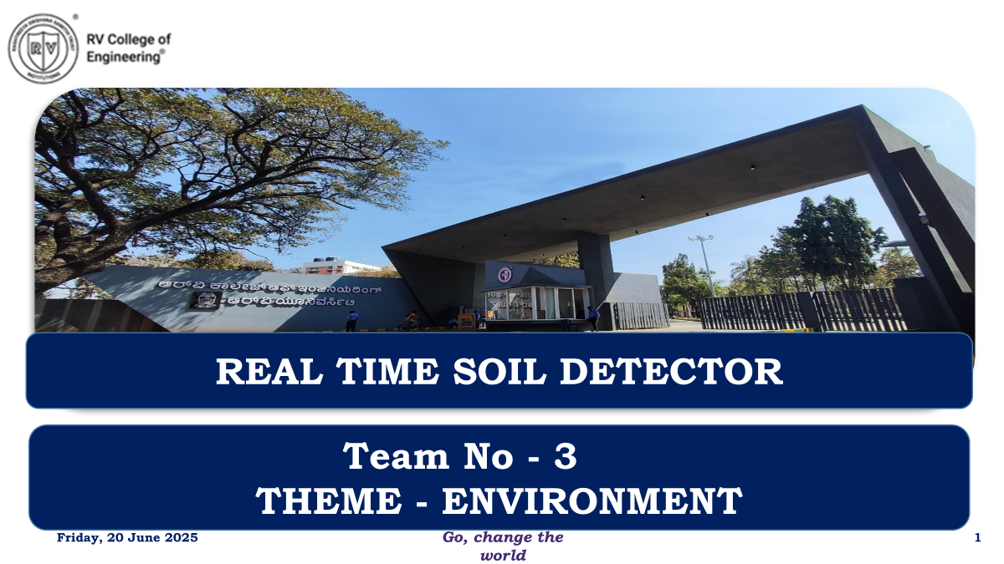

Slide 2
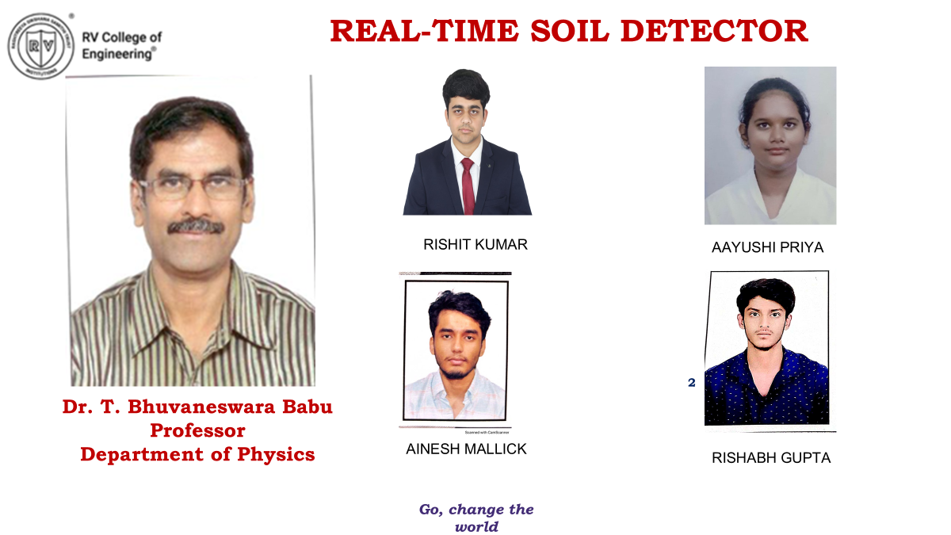



Slide 3
EL Phase-III
Presentation Outline
Introduction
Problem Statement
Objectives
Literature Review
Methodology
Design and Implementation
Components and Tools used
Results/Simulation
Challenges Faced
Final Outcome
Applications
Future Scope
Conclusion
References

Slide 4
Introduction
Agriculture in India faces growing challenges due to poor soil management.
Soil health directly affects crop productivity and environmental sustainability.
Our project provides a real-time soil parameter monitoring system using sensors and microcontroller-based hardware.
Aimed at empowering rural farmers with actionable data to make smarter decisions.

Slide 5
Problem Statement
Farmers in rural and semi-urban parts of Karnataka often face difficulties because they don’t have simple tools to:
Check soil moisture and pH in real-time.
Decide when to water their crops or add fertilizers.
The current solutions available in the market have some major drawbacks:
They are too expensive for small farmers.
They are not easy to carry or use in the fields.
They often need technical knowledge, which many farmers may not have.
Because of this, many farmers:
Use too much or too little water, which harms crops.
Damage the soil over time due to wrong pH and poor water management.
Waste resources like water and fertilizers, increasing farming costs.

Slide 6
Objectives
Develop a low-cost, portable, and user-friendly real-time soil detection system.
Measure key parameters: Moisture, pH, and optionally temperature.
Enable automatic irrigation when moisture drops below a threshold.
Lay groundwork for future upgrades: IoT connectivity, data logging, mobile dashboard.
Promote smart agriculture and eco-friendly practices.

Slide 7
Literature Review
Studied:
Academic papers on soil sensor systems.
Commercial soil testing kits and smart farming devices.
Gaps found:
High cost of existing smart farming kits.
Lack of region-specific calibration (e.g., Karnataka soil types).
Complicated interfaces not suitable for field use.
Our system is:
Affordable
Locally adapted
Wednesday, 02 July 2025

Slide 8
Methodology
Methodology
Selected key components: moisture sensor, pH sensor, ESP32 microcontroller, LCD display, and motor.
Assembled the circuit on a breadboard for easy testing and modification.
Connected sensors to ESP32 to measure real-time soil data (moisture and pH).
Programmed the system using Arduino IDE to:
  Read sensor values
  Display results on LCD
  Automatically activate the motor when moisture is too low
Tested the system in a lab environment to ensure proper functionality and accuracy.

Slide 9
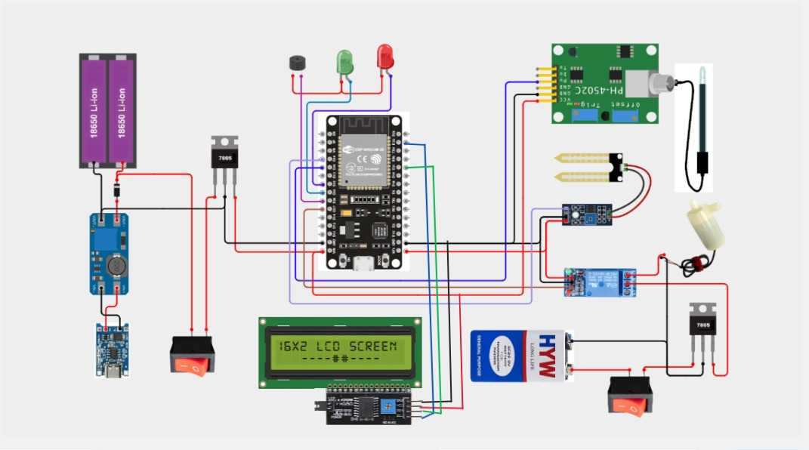
Input block: sensors (moisture, pH)
Processing block: ESP32
Output block: relay, buzzer, LEDs, LCD
Power block: battery, charging & boosting circuit
Wednesday, 02 July 2025

Slide 10
Design and Implementation
Design & Implementation
Modular breadboard design for flexibility and debugging.
Compact hardware assembly.
Emphasis on field-readiness: power backup, LCD readability, waterproofing (in future version).
Used I2C LCD for clean wiring and better power efficiency.
Relay circuit used for triggering motor pump (for irrigation control).

Slide 11
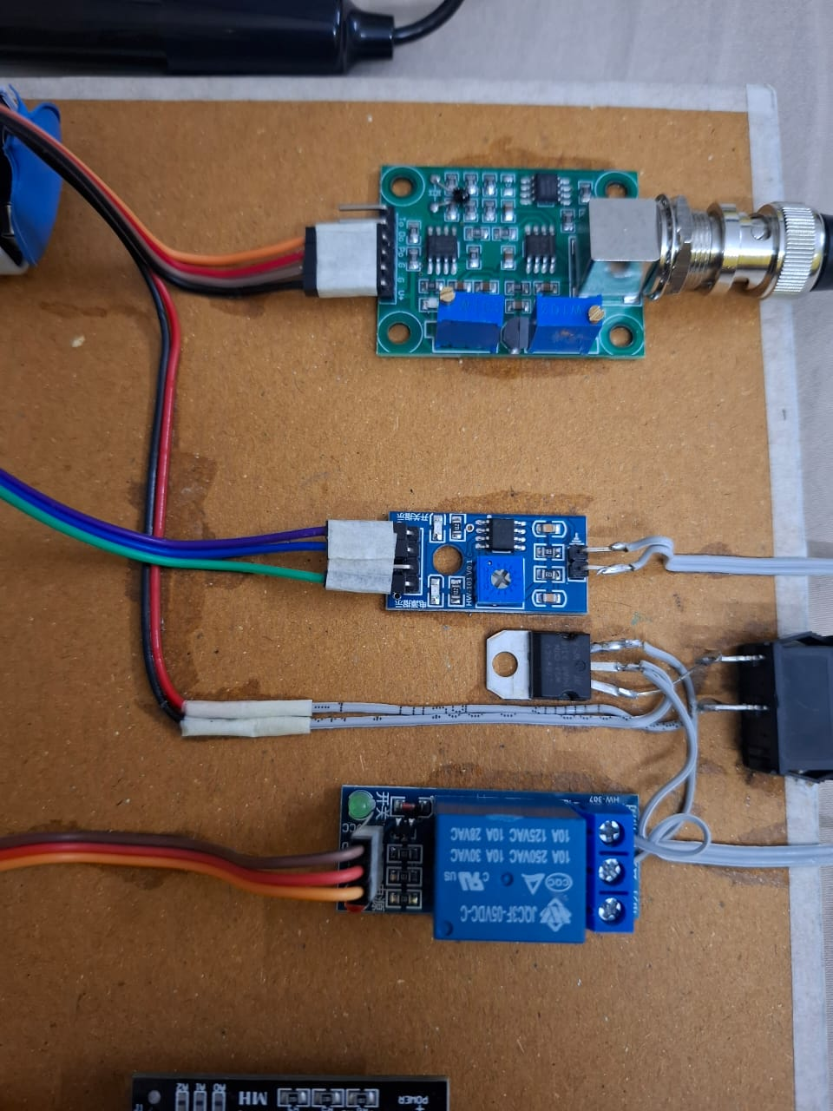
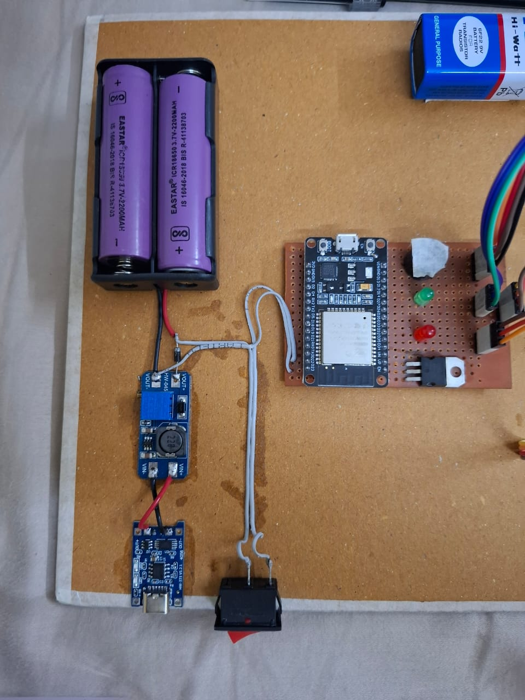
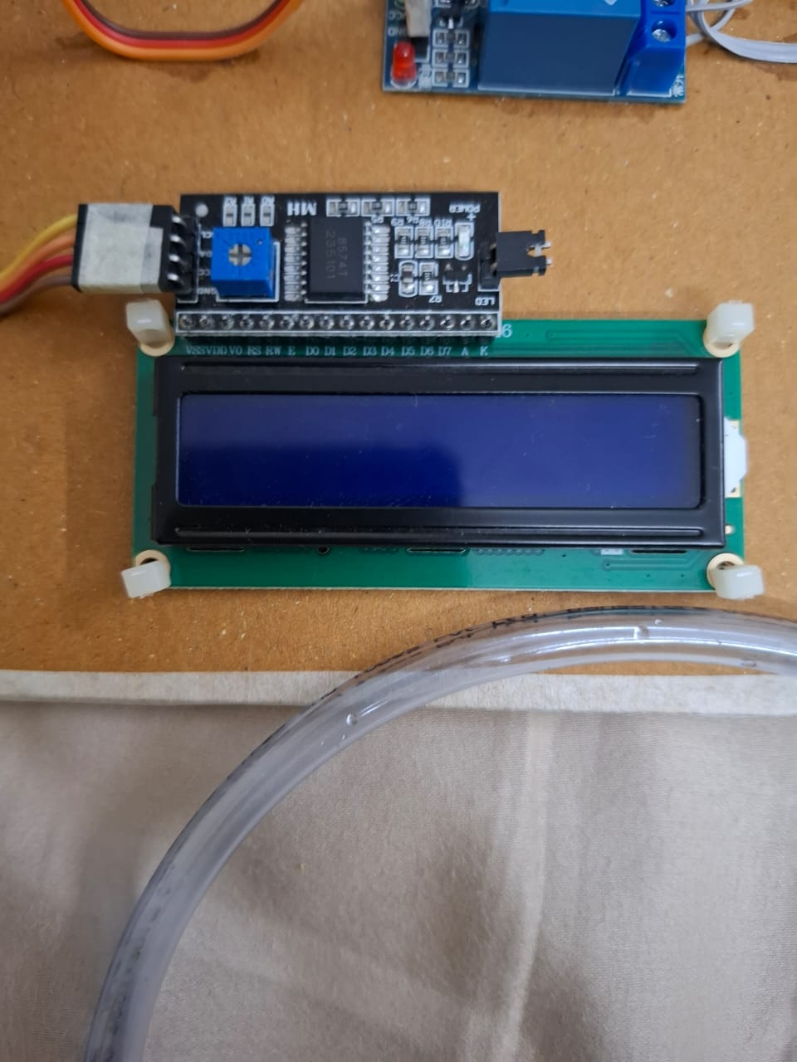
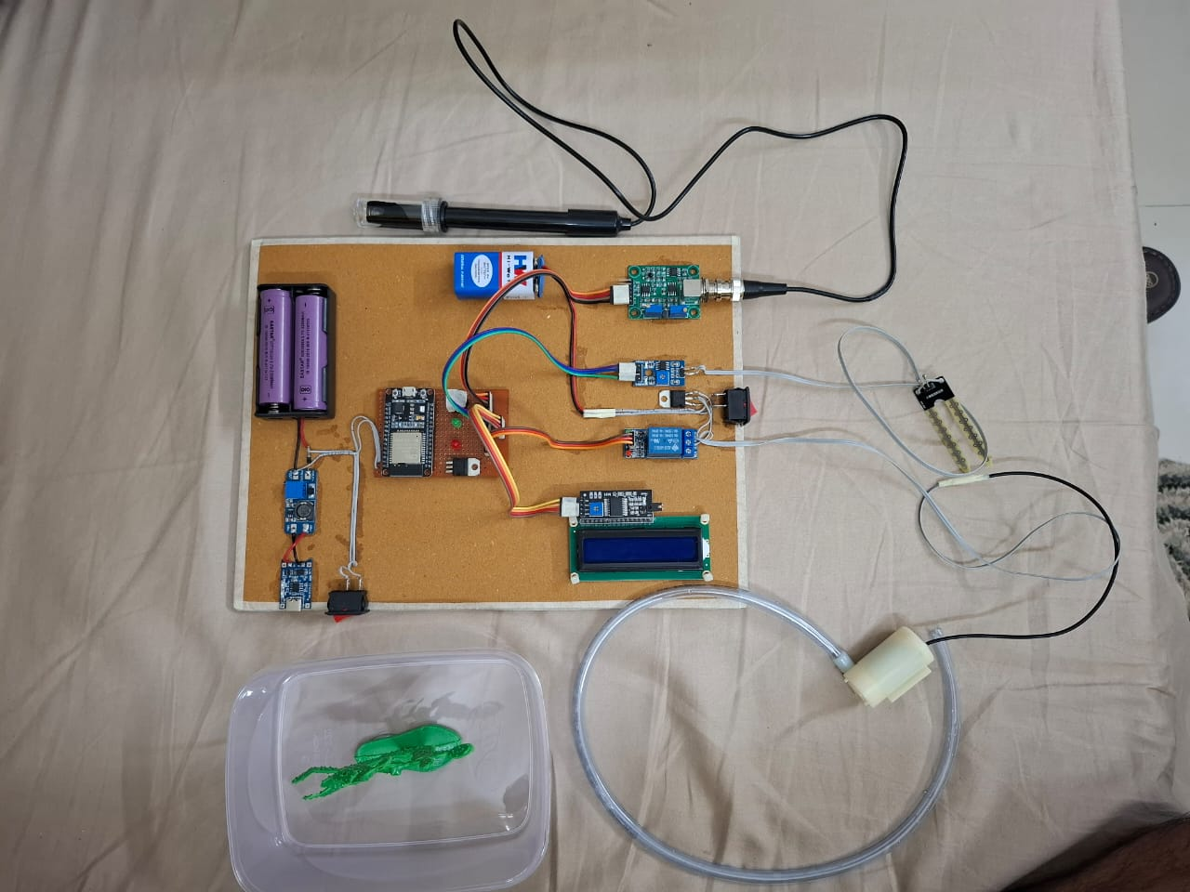
Components and Tools Used
Components & Tools Used
Microcontroller: ESP32 (Wi-Fi capable for future IoT use)
Sensors:
  Capacitive Soil Moisture Sensor
  Analog Soil pH Sensor
  Temperature Sensor (optional)
Display: 16x2 I2C LCD
Power: Rechargeable battery pack (for portability)
Actuator: Relay + Water Motor
Software Tools:
  Arduino IDE

Slide 12
Results/Simulation
Real-time monitoring works effectively:
Moisture values vary clearly between dry and wet soil.
pH sensor reliably distinguishes acidic and neutral soil.
LCD display is clear and readable in daylight.
Motor control logic works:
Auto activation when moisture drops.
Power setup is stable for outdoor use.
Sensors calibrated for soil types found in Karnataka villages.

Slide 13
Challenges Faced
Challenges Faced (Concise)
pH Sensor Issues
  Faced inaccurate and unstable readings.
  Resolved by testing multiple sensor models and calibrating with buffer solutions and pH strips.
Circuit Noise
  Sensor data fluctuated due to interference.
  Fixed using pull-down resistors and signal filtering.
Power Instability
  Voltage drops affected sensor performance.
  Solved by adding a voltage regulator for stable power.

Slide 14
Final Outcome
Successfully developed a working prototype for real-time soil monitoring.
The system is capable of measuring and displaying: soil moistur , soil pH, and temperature(optional)
Real-time readings are clearly shown on an LCD display using I2C communication, making it easy to read even outdoors.
The system is programmed to automatically activate a water motor when soil moisture falls below a set threshold, supporting smart irrigation.
Designed to be portable, powered by a rechargeable battery, and suitable for use in rural and semi-urban fields.
Hardware is mounted and arranged in a modular way to allow easy maintenance and future expansion (e.g., NPK sensors, cloud connectivity).
All components, including ESP32, sensors, LCD, motor, and power system, have been fully tested and integrated.

Slide 15
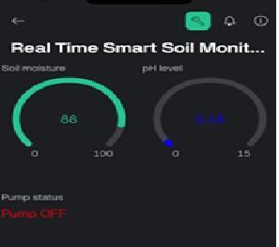
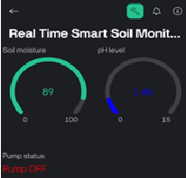
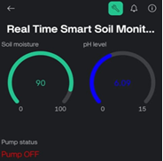
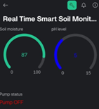
Final Outcome
The prototype is now ready for Phase-III testing, which will involve:
  Field deployment in real farming conditions.
  Collecting data from different soil types in rural Karnataka like Bellandur, Peenya, Devanhalli and Lalbagh

Slide 16
Applications
Precision farming for rural and small-scale farmers.
Support for agricultural extension services and field officers.
Useful in soil research and educational demonstrations.
Can be integrated with government smart farming programs.
Suitable for schools/colleges as lab-based learning tools.
Valuable for NGOs promoting sustainable and eco-friendly agriculture.

Slide 17
Future Scope
Future Scope
Advanced Sensor Integration:
Future versions can include more precise sensors for micro-nutrient detection, soil salinity, and organic content to provide a more comprehensive soil profile.
AI-Based Data Analysis:
Incorporating machine learning models to analyze long-term soil data can help in predicting crop suitability, disease risks, and yield forecasting.
Mobile App Enhancements:
Improve the dashboard with features like:
  Voice assistance in regional languages
  Alert systems for low moisture or nutrient levels
  Offline mode for remote areas
Solar-Powered System:
To make the device more sustainable and field-ready, a solar charging module can be added for energy independence.
Multi-Plot Monitoring:
Expand the system to monitor multiple farm plots using wireless sensor nodes connected to a central unit or cloud.
Collaboration with Government Schemes:
Integration with platforms like Digital India, PM-Kisan, or Smart Farming initiatives can help scale the solution to benefit a larger farming community.

Slide 18
Future Scope
Areas for Further Research
Soil-specific calibration models for different agro-climatic zones.
Impact assessment of sensor-based irrigation on crop yield and water conservation.
Developing open-source datasets for Indian soil conditions.
Studying long-term environmental benefits of precision farming using IoT-based tools.

Slide 19
Conclusion
This project successfully delivered a real-time soil monitoring system that addresses the challenges faced by farmers in rural and semi-urban areas. The prototype measures essential soil parameters like moisture, pH, NPK levels, and electrical conductivity, while also integrating cloud connectivity, a mobile dashboard, and weather-based irrigation prediction.
We have met all the core objectives:
Built a low-cost, portable, and user-friendly device.
Enabled automated irrigation based on real-time soil data.
Incorporated data logging and remote access to assist in long-term soil and crop management.
Designed the system to be scalable and adaptable for future use in smart farming initiatives.
Through field testing and iterative improvements, the system is now ready for real-world deployment, offering farmers an effective tool to improve productivity, conserve resources, and adopt data-driven agricultural practices.

Slide 20
Acknowledgments
We would like to express our sincere gratitude to Dr. T. Bhuvaneswara Babu, Professor, Department of Physics, for his continuous guidance, technical insights, and encouragement throughout the course of this project.
We extend our heartfelt thanks to the Department of Physics and our institution for providing the necessary resources, infrastructure, and a supportive environment that enabled us to successfully complete our work.

Slide 21
References
[1] DFROBOT, “Gravity: Analog Capacitive Soil Moisture Sensor v1.2,” [Online]. Available: https://wiki.dfrobot.com/Capacitive_Soil_Moisture_Sensor_SKU_SEN0193
[2] Lily Electronics, “TP4056 Li-Ion Battery Charging Module,” [Online]. Available: https://www.lilygo.cc/products/tp4056-charging-module
[3] RobotDyn, “MT3608 DC-DC Boost Converter Datasheet,” [Online]. Available: https://www.robotdyn.com/mt3608-dc-dc-boost.html
[4] Arduino, “Arduino IDE 2.0 Documentation,” [Online]. Available: https://docs.arduino.cc/software/ide-v2
[5] F. Malpartida, “NewLiquidCrystal Library,” GitHub, [Online]. Available: https://github.com/fmalpartida/New-LiquidCrystal

Slide 22


